Slide 1

License Plate Recognition
COMPUTER VISION
Clayton McArthur, Ella Williams, Maxx McArthur

Slide 2
TABLE OF CONTENTS
01
02
03
Overview
Implementation
Live Demo

Slide 3
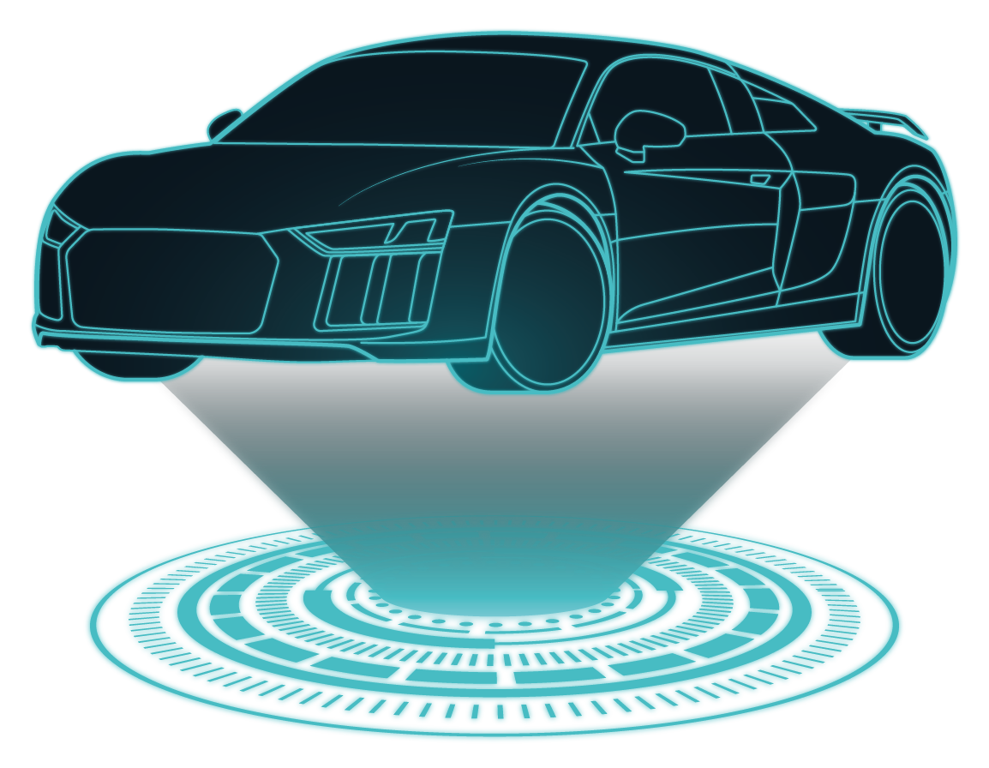
01
Overview

Slide 4
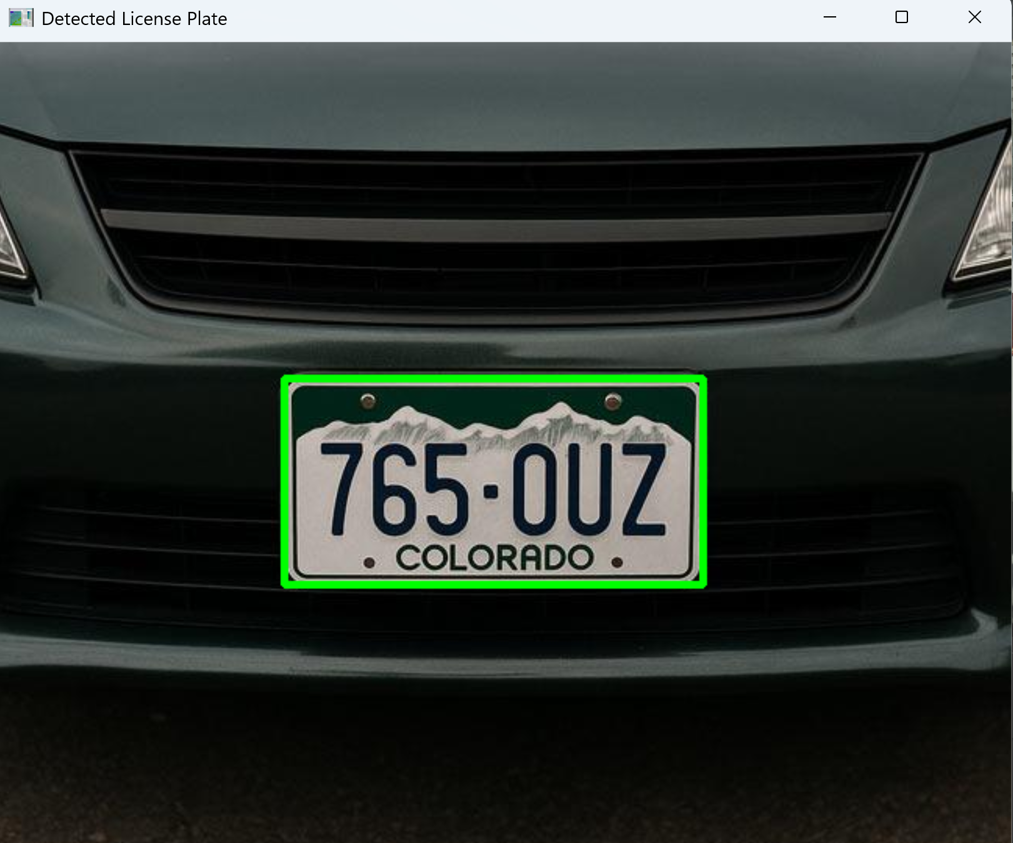
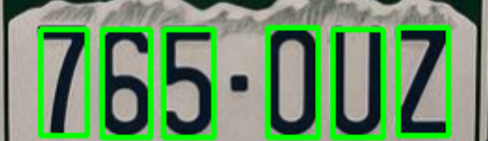
What is License Plate Recognition?
Automatic License Plate Recognition (ALPR): Detects and reads license plates automatically from images and videos.
Commonly used in:
Parking systems
Toll booths
Traffic monitoring
Security systems
Combines:
Computer Vision
Image Processing
Machine Learning

Slide 5
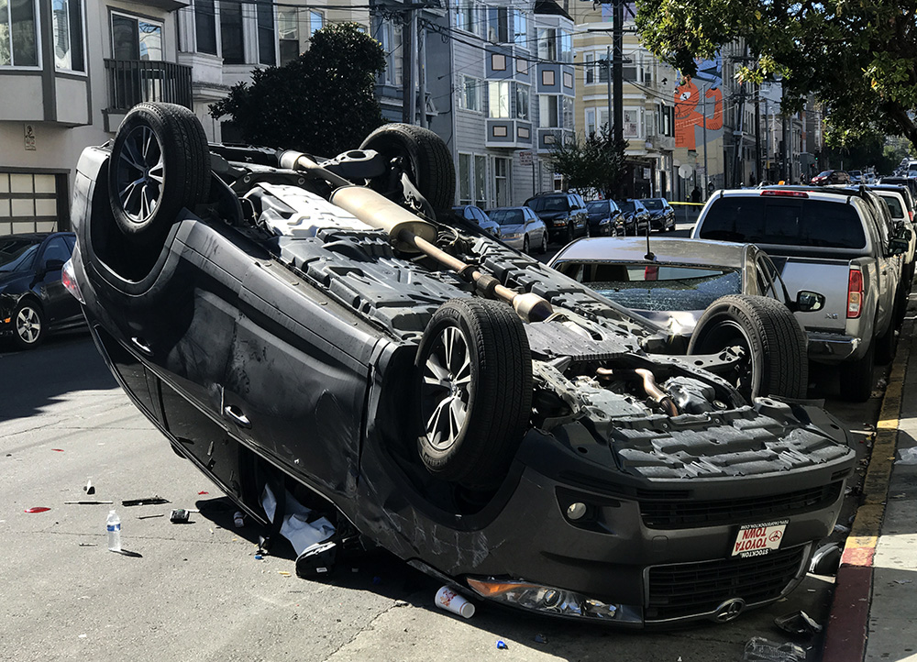
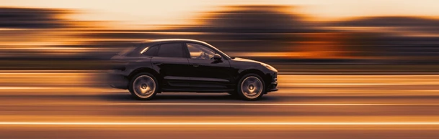
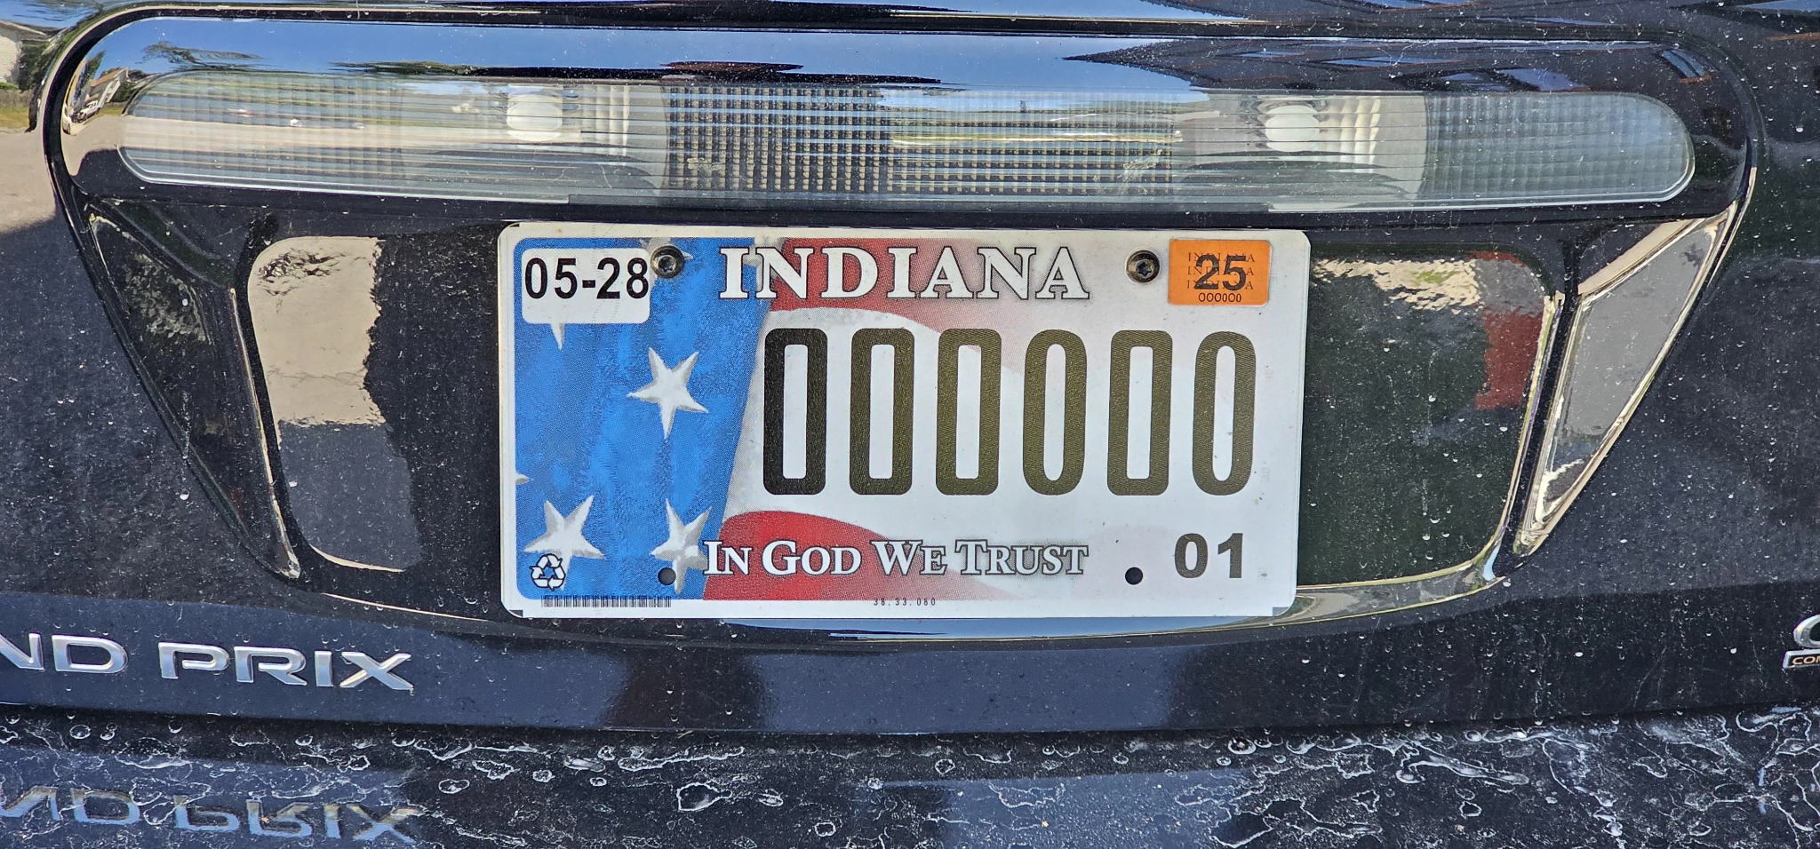
Challenges
Some of the main challenges with license plate recognition are as follows:
Different lighting variation
Motion blur
Rotated plates
Different fonts and spacing
Similar looking characters:
O vs 0
I vs 1
B vs 8

Slide 6
OCR Pipeline
1st
2nd
3rd
4th
Input Image
License Plate Detection
License Plate Extraction
Preprocessing
5th
6th
7th
8th
Character Segmentation
HOG Feature Extraction
SVM Classification
Final Plate Prediction
Notes:
OCR: Optical Character Recognition

Slide 7
02
Implementation

Slide 8
1. License Plate Detection
Goal: Detect the most likely license plate region in a vehicle image before passing it to character detection.
Candidate Filtering:
Finds rectangular regions using contours
Filters by license plate shape: wide aspect ratio, reasonable size, and mostly horizontal orientation
Removes unlikely regions such as headlights, bumpers, logos, or image borders
Ranking System: Each candidate receives a score based on:
Aspect ratio: favors wide US plate-like rectangles
Edge density: rewards regions with strong internal detail
Character-like content: looks for repeated vertical shapes similar to letters/numbers
Rectangularity: favors clean rectangular regions
Location/angle: gives small preference to realistic plate positions and orientations
Result: The highest-scoring region is selected, highlighted, cropped, and perspective-corrected before being sent to the character detection stage.

Slide 9
Detection Pipeline
1st
2nd
3rd
4th
Input Image
Grayscale
Edge Detection
Morphology
5th
6th
Contours
Candidate Ranking
Notes:
OCR: Optical Character Recognition

Slide 10

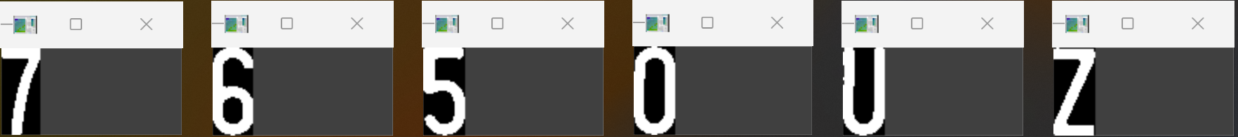
2. Text Detection
Goal: Isolate each individual license plate character for OCR recognition.
Process:
Convert plate image to grayscale
Apply blur and Otsu thresholding to create a binary image
Detect contours representing possible characters
Filter contours using:
Size
Aspect ratio
Area
Sort characters left to right
Crop each character into its own image
Why it matters: Good segmentation is critical because OCR accuracy depends on receiving clean, isolated characters.

Slide 11
3. Text Recognition (Considered Options)
Method | Pros | Cons
Terrasect | Super easy to use | Outside library Not base C++ and OpenCV
Template Matching | Simple Easy | Needs strong templates Sensitive to noise
HOG & SVM | Fast Accurate | Requires extensive templates Requires training
CNN/Deep Learning | Very accurate | Heaving to compute Requires lots of data
We chose this one!
Notes:
Summary: HOG converts each character into edge-based numerical features, and the SVM uses those features to classify the character as a specific letter or number.

Slide 12
3. Text Recognition
HOG
(Histogram of Gradients)
SVM
(Support Vector Machine)
Extraction
Converts character images into numerical feature vectors
Detects edge directions and stroke patterns
Captures character shape information
Classification
Trains on custom labeled character templates
Separates characters into feature-space categories to predict most likely character
Works well with HOG feature vectors
Notes:
Summary: HOG converts each character into edge-based numerical features, and the SVM uses those features to classify the character as a specific letter or number.

Slide 13
03
Live Demo

Slide 14
Sources
https://www.congress.gov/crs-product/IF13068
https://hypotenuselabs.medium.com/an-ocr-pipeline-for-machine-learning-the-good-the-bad-and-the-ugly-9ae751314ce6
https://ijircce.com/admin/main/storage/app/pdf/6arQiGR3QJuryKoSmEx31Be1dcUXyywoGMbYDT6R.pdf
https://pyimagesearch.com/2020/09/21/opencv-automatic-license-number-plate-recognition-anpr-with-python/
https://learnopencv.com/histogram-of-oriented-gradients/
Images
https://missionlocal.org/2017/03/crash-leaves-car-flipped-on-26th-and-shotwell-streets/
https://www.shutterstock.com/image-photo/fast-car-abstract-photo-speed-blur-2485659189?dd_referrer=https%3A%2F%2Fwww.google.com%2F
https://www.reddit.com/r/mildlyinteresting/comments/1dpyax1/this_license_plate_of_o_0/

Slide 15
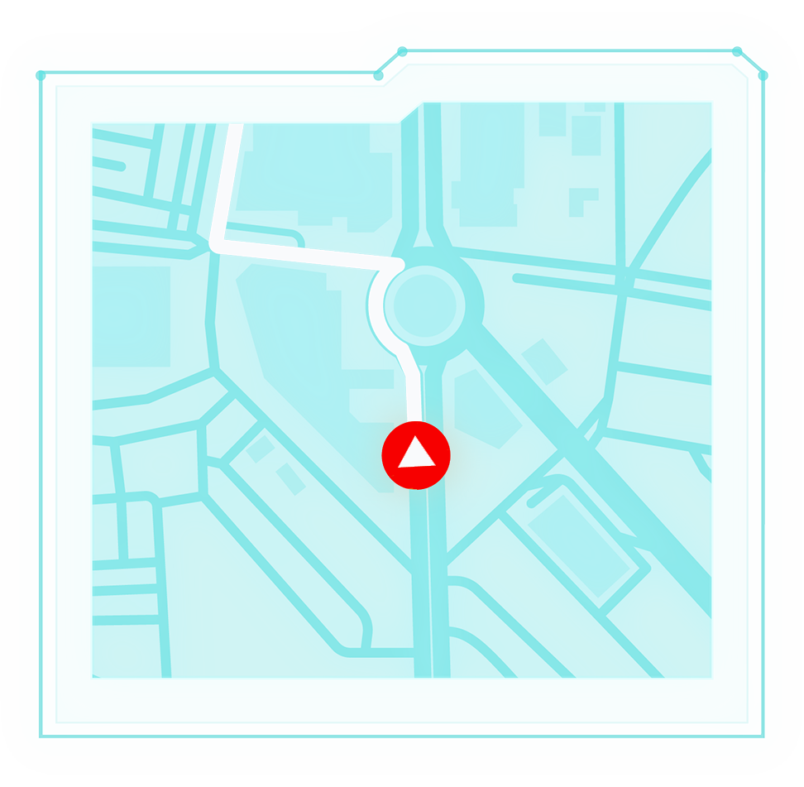
ANY QUESTIONS?

Slide 16


THANKS!

Slide 17


